Slide 1


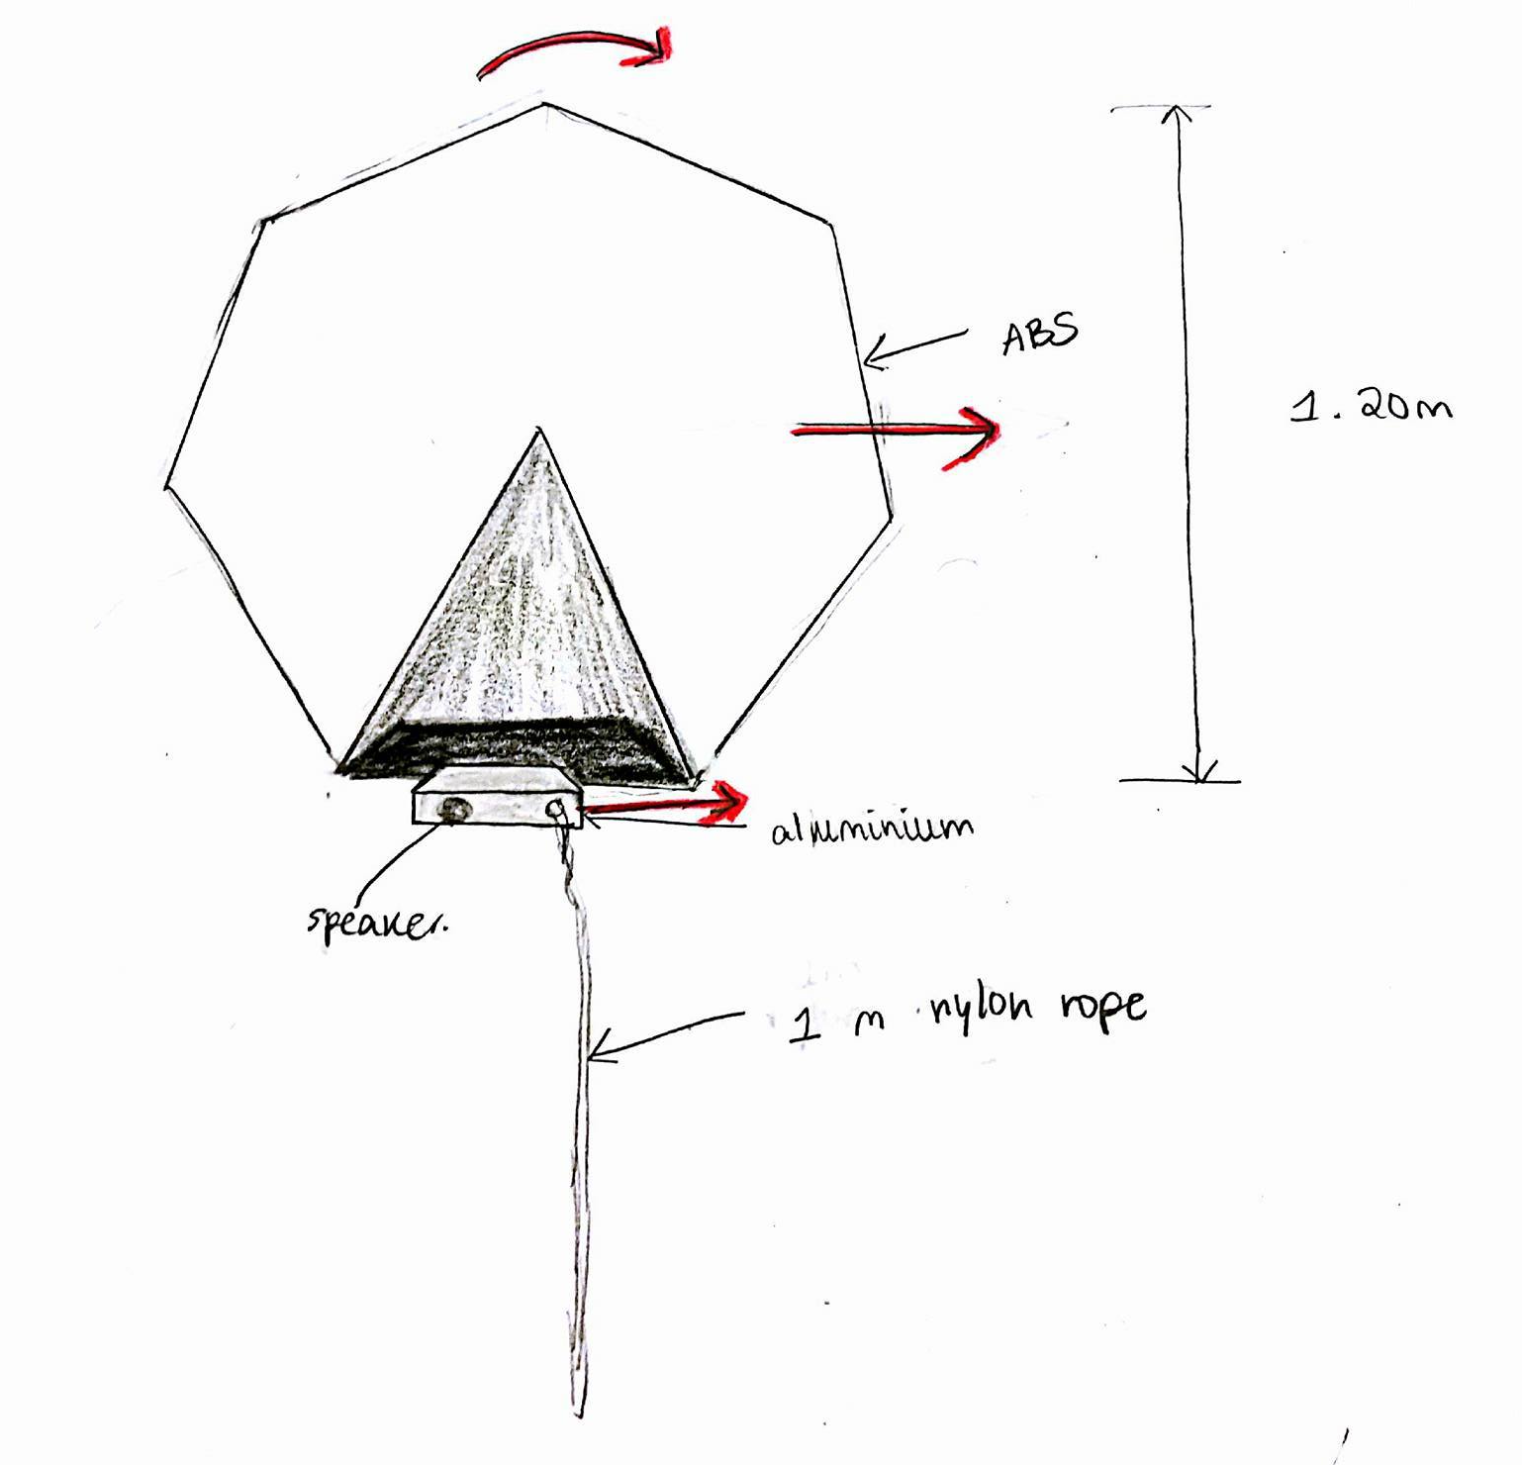
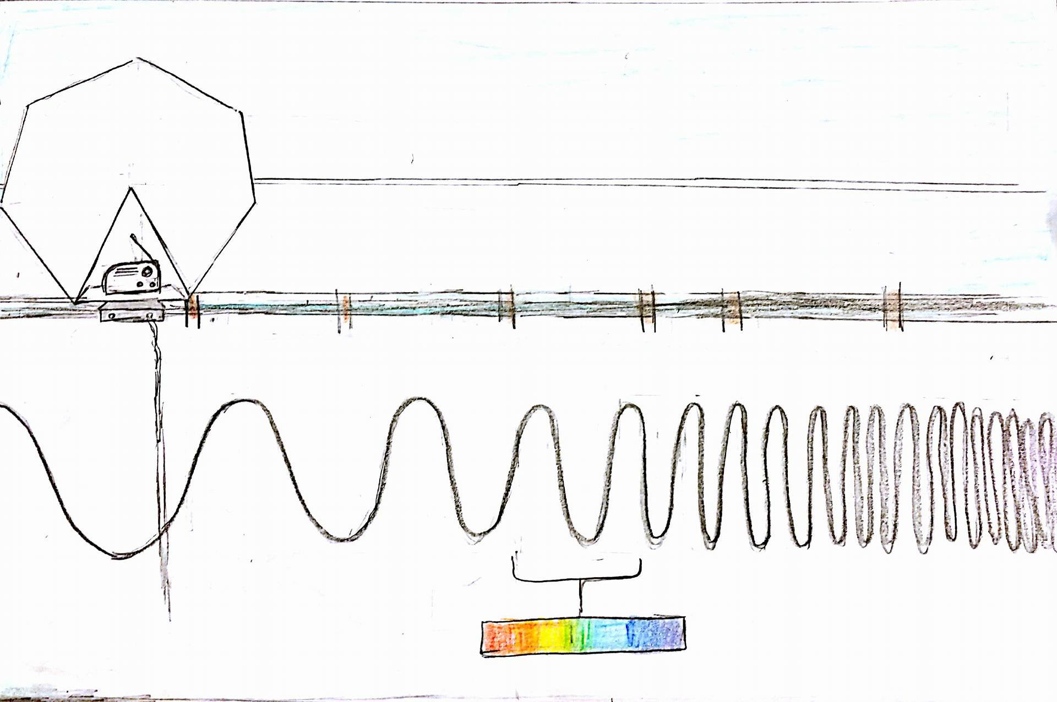
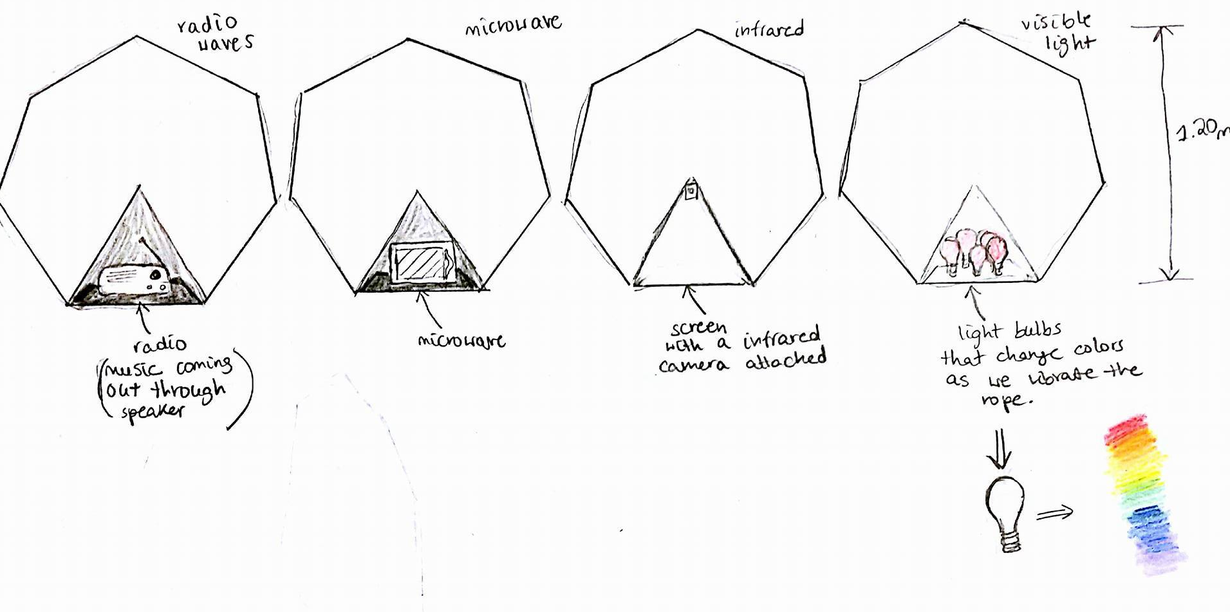
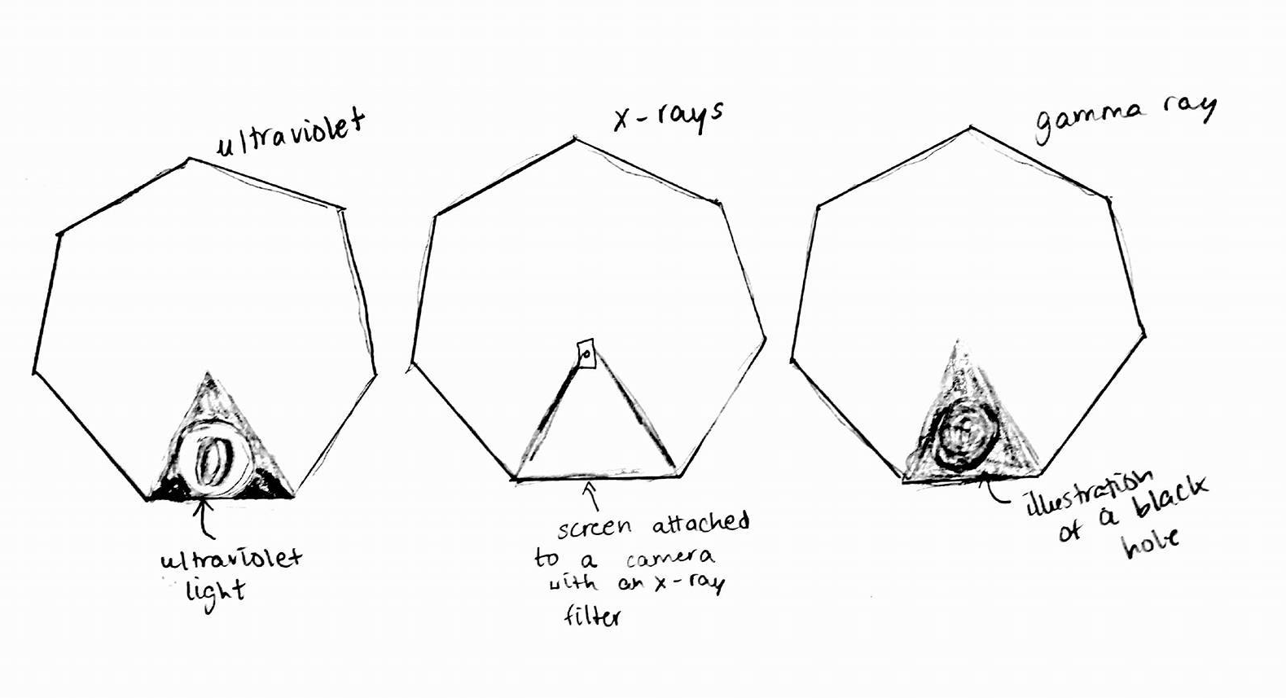
Interactive Heptagon
Eva Dibong and Jung Yun Oh
Women’s Technology Program in Mechanical Engineering
Abstract
Introduction
Museum installations are works of art that are both educational and interactive. Their audiences are able to visualize and learn concepts through modeling and hands-on activities. Our goal was to design an installation for a science museum that was accessible to people of all ages and levels of education. We chose to model the electromagnetic spectrum because we wanted to demonstrate the variety of its effects and uses as well as its importance. Through brainstorming and sketching, we came up with a final design that incorporates both kinetic and instructive interaction.
Electromagnetic radiation is an essential part of daily life. It produces the colors we see, heats the food we eat, and provides news and music. It is composed of electric and magnetic fields, and there are seven different types of waves: radio waves, microwaves, infrared, visible light, ultraviolet, x-rays, and gamma rays. Electromagnetic radiation is omnipresent, and by understanding the physics behind it, people are able to protect themselves from it or wield it as tools. Through this installation, people are able to learn about electromagnetic radiation, its effects, and its uses.
Components
Heptagonal wheel sectioned into 7 triangles
Markers for rotation
Sliding mechanism
Railings
Nylon rope
Accelerometer
Microcontroller
Speaker
Wavelength diagram
Informational text
Mechanism
Shaking a rope models an electromagnetic wave.
Accelerometer detects the acceleration and frequency.
Frequency is translated to wavelength through wavelength= velocity/frequency (λ=v/f)
A program will command the heptagonal wheel to move to the designated wavelength.
The heptagonal wheel will hit a marker that will rotate wheel to the section about that type of radiation.
A speaker will explain the informational text provided below.
Conclusion
Acknowledgements
References
Through interaction with the installation, people are able to learn about the electromagnetic spectrum in a unique and interesting way. The kinetic movements and sections of the installation captures the audience’s attention, and the text and audio presents information about each type of radiation.
Mentor: Alice Nasto
Dr. Hughey
Marian Heman-Ackah
Kira Street
http://imagine.gsfc.nasa.gov/science/toolbox/emspectrum1.html
http://hyperphysics.phy-astr.gsu.edu/hbase/ems1.html
http://www.dimensionengineering.com/info/accelerometers
July 15, 2016

